Slide 1

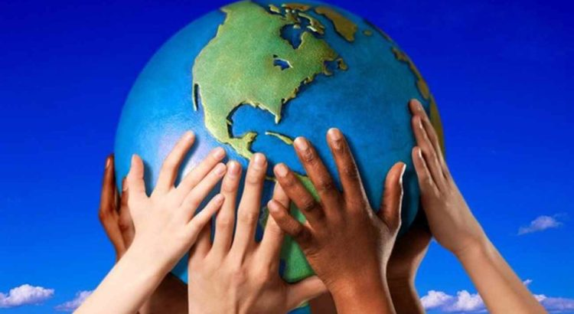
ACTIVE CITIZENSHIP
David Ilcu Nº7; Diogo Teles Nº 9; Danisberto Neto Nº6; Djibril Soumah Nº11; Geovanny Almeida Nº12; Rodrigo Xavier Nº20;

Slide 2

THE CONCEPT OF ACTIVE CITIZENSHIP
As we know, citizenship is the condition of a citizen in relation to his/her nation.
So, that citizen feature is what gives him/her a set of rights and civil obligations to be respected.
However, active citizenship is a concept that applies to all people who integrate and commit to the community. That is to say, the active citizen gets absolutely involved in all matters corresponding to the community where he lives and participates.

Slide 3
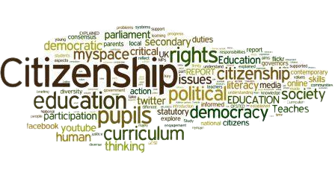
ACTIVE CITIZENSHIP AND HUMAN RIGHTS
Citizenship is the fundamental right of all people to have rights, without distinction. The state of citizenship is the level in which the rights are equal as reference to all members of the community, regardless of their situation and condition.
The rights and responsibilities of all citizens are the two sides of this political relationship of equality, as a shared relationship. If not so, that is, where the existence of a right implicates its denial to all others, such rights become privileges.

Slide 4
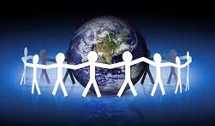
HOW TO BE A GOOD CITIZEN
Good citizens are actively envolved in their community, in favour of their fellow citizens.
They are proud of the place they live and work hard to make it even better.
We all appreciate recognition as good citizens, being that any person can be a good one with a little reflection and effort.

